Slide 1
Can, can‘t

Slide 2
CAN
I CAN SWIM. Umím plavat.
I CAN COOK. Umím vařit.

Slide 3
CAN‘T
I CAN‘T SWIM. Neumím plavat.
I CAN‘T COOK. Neumím vařit.

Slide 4
CAN………..VERY WELL.
I CAN SWIM VERY WELL. Umím velmi dobře plavat.
I CAN COOK VERY WELL. Umím velmi dobře vařit.

Slide 5
CAN‘T ……….VERY WELL
I CAN‘T SWIM VERY WELL. Neumím moc dobře plavat.
I CAN‘T COOK VERY WELL. Neumím moc dobře vařit.

Slide 6
škála
I CAN SWIM VERY WELL. 100%
I CAN SWIM. 75%
I CAN‘T SWIM VERY WELL. 25%
I CAN‘T SWIM. 0%

Slide 7
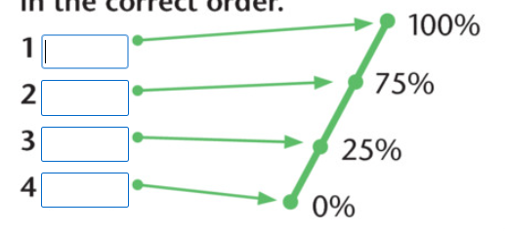
VERY WELL = VELMI DOBŘE
DOPLŇ:

